Slide 1

Rescue Link – Ambulance Dispatch And Tracking
Name: Y. Charan Sai(2520030173)
G.B Vedaditya()
Guide Name: Dr. NirmalaJyothi
Section: 6

Slide 2
Problem Statement
Manual ambulance allocation can cause response delays.
Difficult to track emergency incidents efficiently.
Poor coordination between ambulances and medical crews.
Lack of centralized monitoring and management.
Challenges in maintaining ambulance availability records.
Need for a system that supports real-time tracking and dispatch operations.

Slide 3
Proposed Solution
Develop a centralized web-based ambulance management platform.
Enable quick registration of emergency incidents.
Automate ambulance allocation and crew assignment.
Provide real-time tracking of emergency response activities.
Maintain incident, fleet, and crew records through a dashboard.
Improve coordination and reduce emergency response delays.

Slide 4
Technologies used
React.js
LocalStorage
Bootstrap
Html
JavaScript
Routers

Slide 5
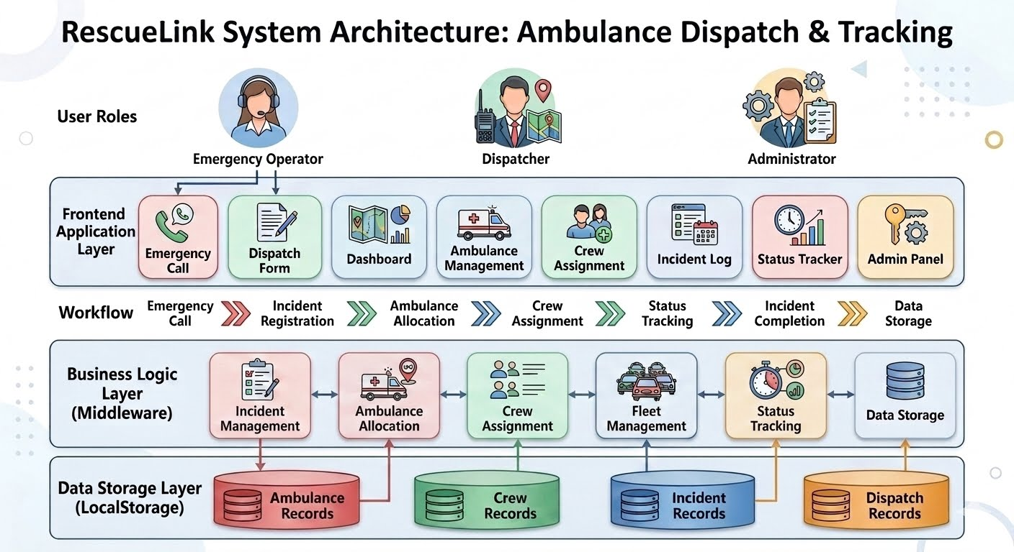
System Architecture

Slide 6
Modules Implemented
Dashboard-Shows active , completed incidents and provides quick system overview
Dispatch Form-Registers emergency incidents
Ambulance Management-Maintains ambulance records and Tracks Availability
Crew Assignment-Assigns drivers and paramedics
Status Tracker-Updates emergency response stages

Slide 7
Key Features
Emergency Incident Registration• Ambulance Allocation
Crew Assignment
Real-Time Status Tracking
Fleet Management
Incident Record Maintenance
Dashboard Monitoring
Local Storage Data Persistence

Slide 8
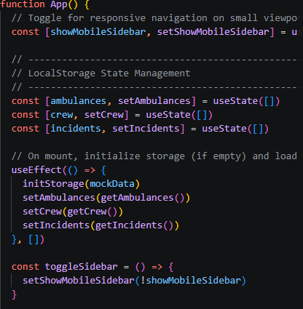
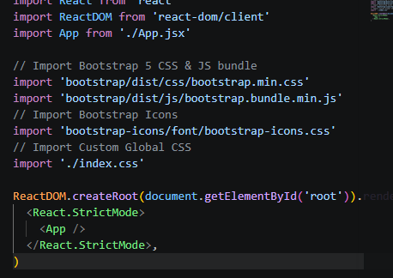
Code Screenshots

Slide 9
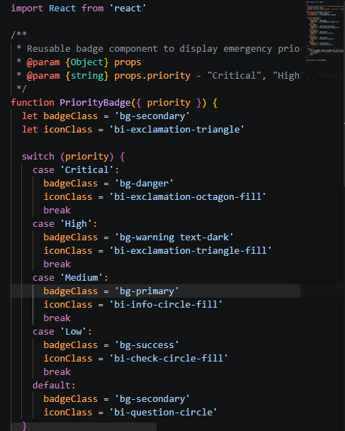
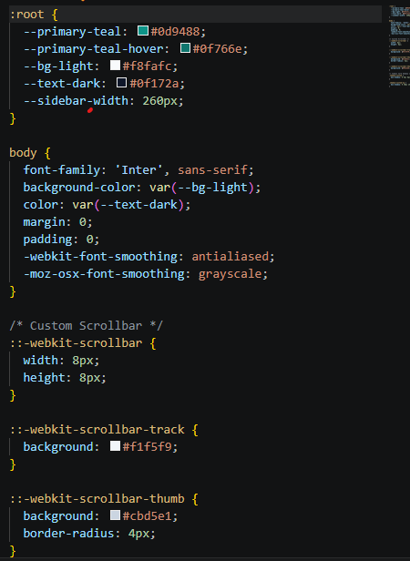

Slide 10
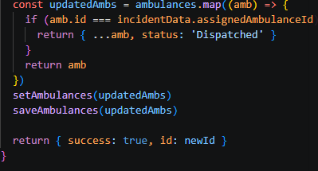
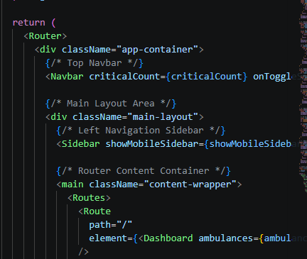

Slide 11
Conclusion
Provides a centralized platform for emergency response management.
Streamlines ambulance allocation and crew assignment.
Enables efficient incident tracking and status monitoring.
Improves coordination and reduces response delays.
Enhances operational efficiency during emergencies.
Demonstrates the effective use of React.js, Bootstrap, and Local Storage

